Slide 1
UNCERTAINTY QUANTIFICATION OF AGENT-BASED MODELS WITH APPLICATION TO MALARIA INTERVENTION MODELING
PhD Update
16th October 2024

Slide 2
Aim
To quantify and propagate the uncertainty from various parameters in the OpenMalaria Ghana model, beyond just the entomological inoculation rate (EIR) and to determine the impact of these uncertainties on simulating the effect of malaria interventions at the sub-national level.

Slide 3
Uncertainty Quantification can be classified in two forms
The field of Uncertainty Quantification offers a means of quantifying and characterizing uncertainties in models and the real world.
Forward Propagation of Uncertainty
Investigates the impacts of random input values of model parameters on model outputs
Inverse Uncertainty Quantification
using experimental data to learn about the sources of modeling uncertainty
Sensitivity Analysis
Model Calibration

Slide 4
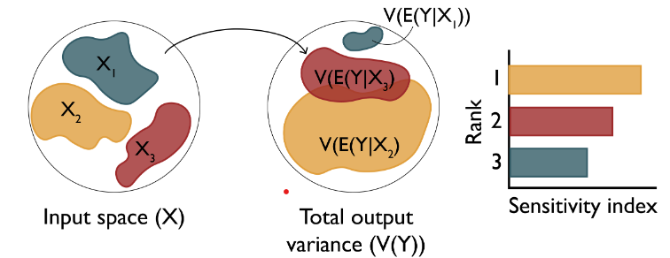
Research Objectives
Objective 1: Understand the key drivers of impact of malaria interventions in Ghana
Objective 3: Simulate the impact of malaria interventions in Ghana in order to support decisions for strategic planning
Objective 2: Develop a novel inference framework for calibrating the OpenMalaria model at a higher spatial resolution
Perform sensitivity analysis of coverage, halflife of efficacy and vector composition towards prevalence reduction and clinical cases averted (Forward propagation of uncertainty)
Results of the sensitivity analysis will help the NMEP to carefully choose intervention re-allocation if needed, during the midterm review
The sensitivity analysis will be integrated in the OpenMalaria workflow package, which will be made publicly available
Source: Sensitivity Analysis: The Basics

Slide 5
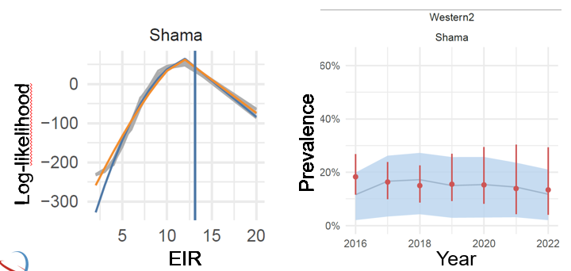
Research Objectives
Objective 1: Understand the key drivers of impact of interventions in Ghana
Objective 3: Simulate the impact of malaria interventions in Ghana in order to support decisions for strategic planning
Objective 2: Develop an efficient inference framework for calibrating the OpenMalaria model at a higher spatial resolution
Develop framework to infer multiple parameters and perform uncertainty quantification for malaria interventions applied to the Ghana data (Inverse uncertainty quantification)
a fully implemented, tested, and documented sampling-based inference framework. This framework will be used to calibrate the OpenMalaria Ghana model
Source: MAP / OpenMalaria simulations
Source: MAP / OpenMalaria simulations
Source: MAP / OpenMalaria simulations
Source: MAP / OpenMalaria simulations

Slide 6
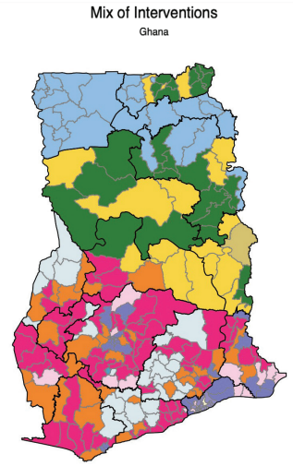
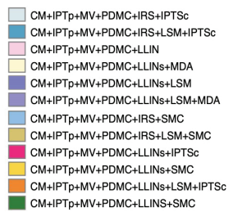
Research Objectives
Objective 1: Understand the key drivers of impact of interventions in Ghana
Objective 3: Simulate the impact of malaria interventions in Ghana in order to support decisions for strategic planning
Objective 2: Develop a novel inference framework for calibrating the OpenMalaria model at a higher spatial resolution
refine modeling scenarios for Ghana at the district level and define prioritization criteria for combinations of interventions
Source: Ghana NMESP 2024-2028.

Slide 7
Progress Update – MAIN ACTIVITIES
ACTIVITY | DATE (2024)
COURSES (10 ECTS) | FEBRUARY – JUNE
OPENMALARIA TRAINING | MAY – JULY
PROPOSAL WRITING, PRESENTATION AND SUBMISSION | FEBRUARY – AUGUST
OBJECTIVE 1 | SEPTEMBER – ONGOING
Notes:
To address uncertainties, we identify and quantify the various sources of uncertainty in intervention modeling

Slide 8
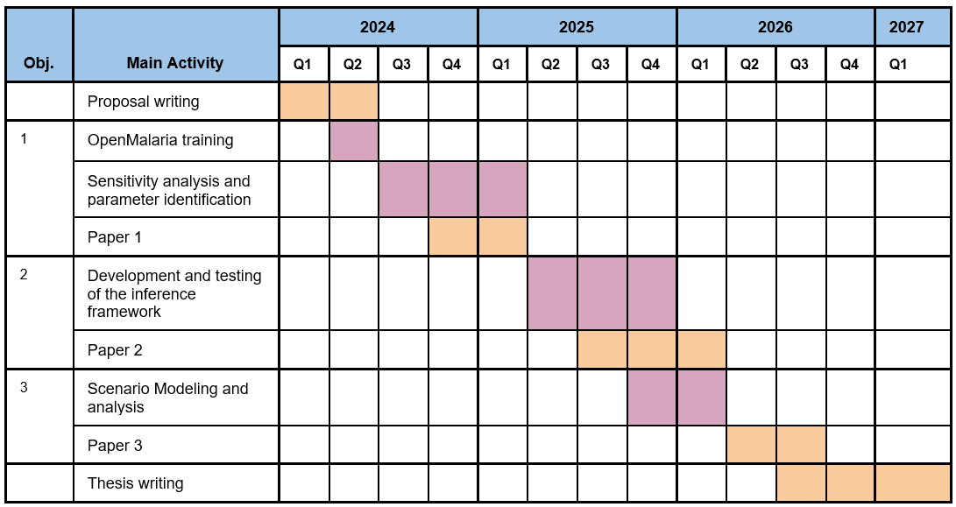
Progress Update – Timeplan (Oct 2024)
Notes:
To address uncertainties, we identify and quantify the various sources of uncertainty in intervention modeling

Slide 9
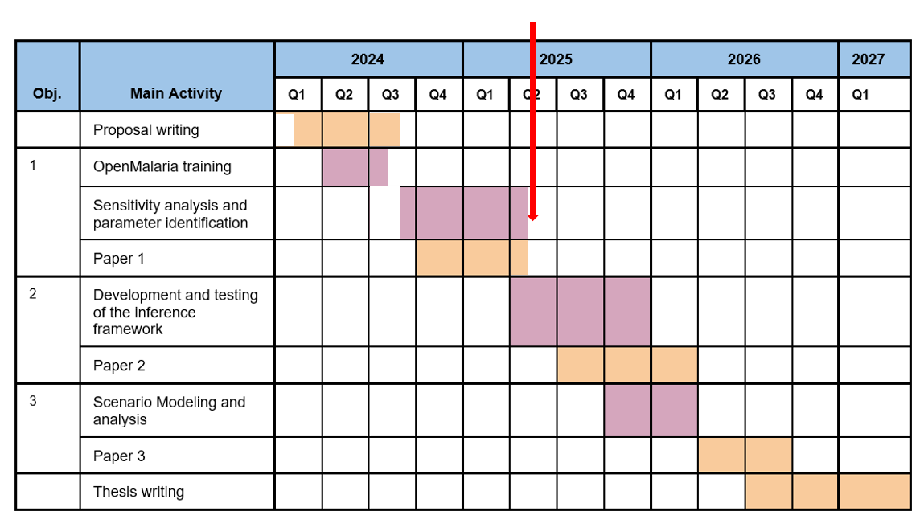
Progress Update – Timeplan (May 2025)
Notes:
To address uncertainties, we identify and quantify the various sources of uncertainty in intervention modeling

Slide 10
Objective 1
Perform sensitivity analysis of coverage, halflife of efficacy and vector composition towards prevalence reduction and clinical cases averted.
Perform sensitivity analysis of future intervention coverage towards prevalence rate in the Upper East4 region, Ghana
3 Interventions: LLINS, SMC, RTSS
OAT and Sobol’ sensitivity analysis
Historical intervention coverage for GA and NE
Future intervention coverage for Ashanti1 and Upper East4
Notes:
To address uncertainties, we identify and quantify the various sources of uncertainty in intervention modeling

Slide 11
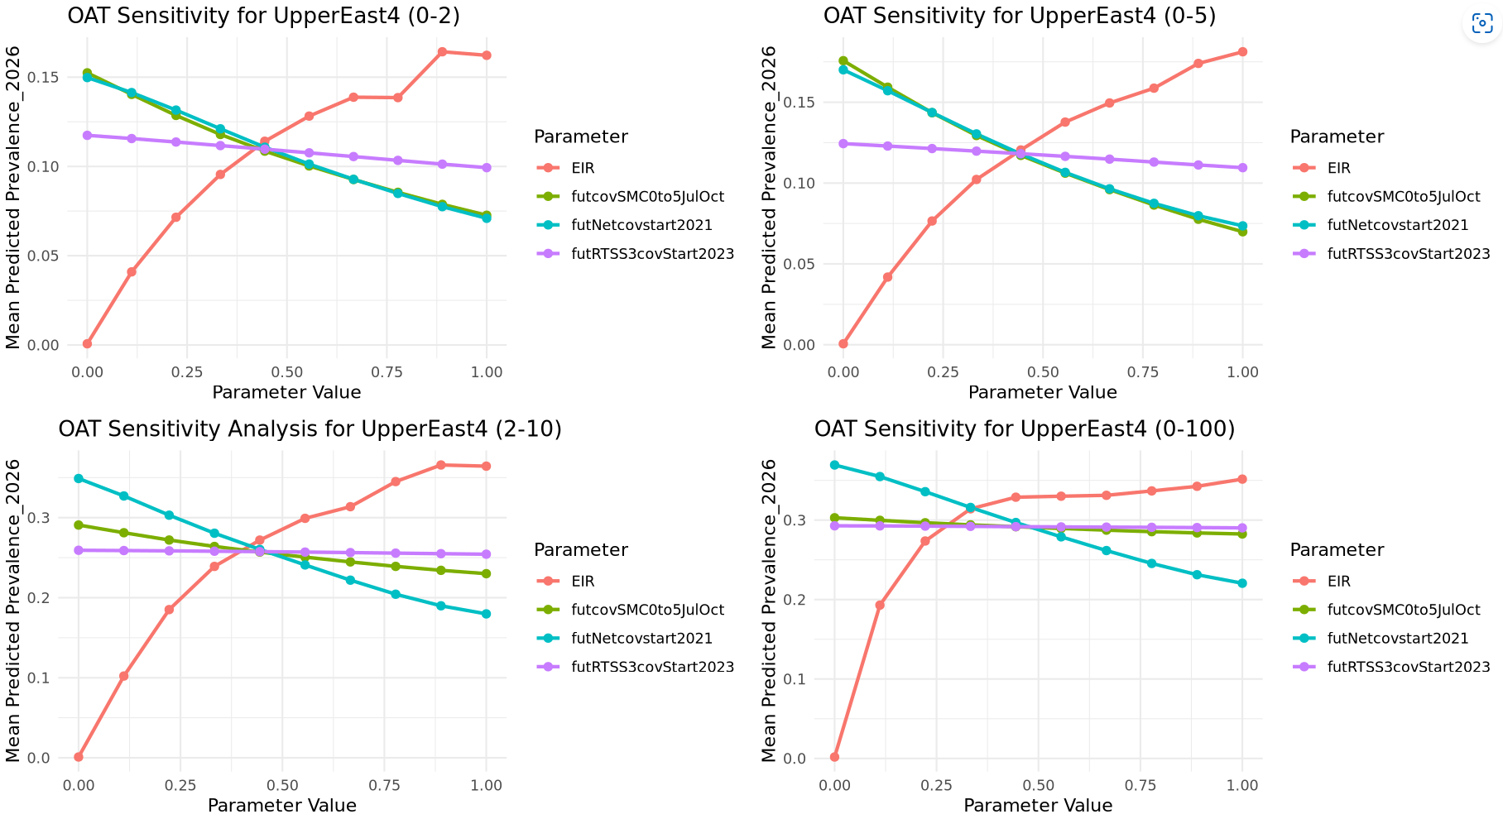
Objective 1 – OAT Sensitivity (EIR AS A PREDICTOR IN BOTH TRAINING AND PREDICTION)

Slide 12
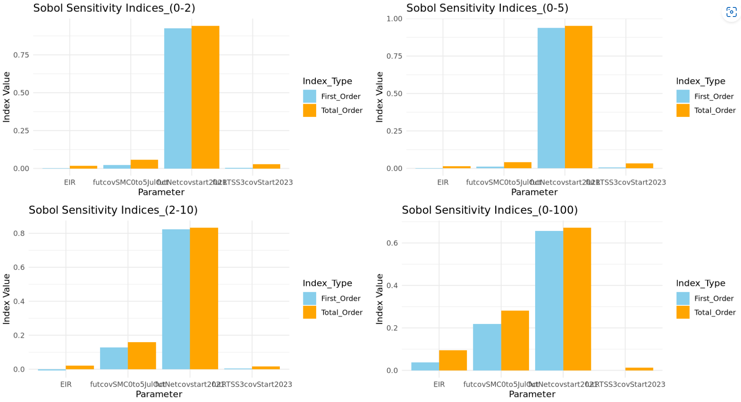
Objective 1 – Sobol’ Sensitivity (FULL EIR RANGE FOR TRAINING AND PREDICTION (LHS SAMPLING))
Notes:
To address uncertainties, we identify and quantify the various sources of uncertainty in intervention modeling

Slide 13
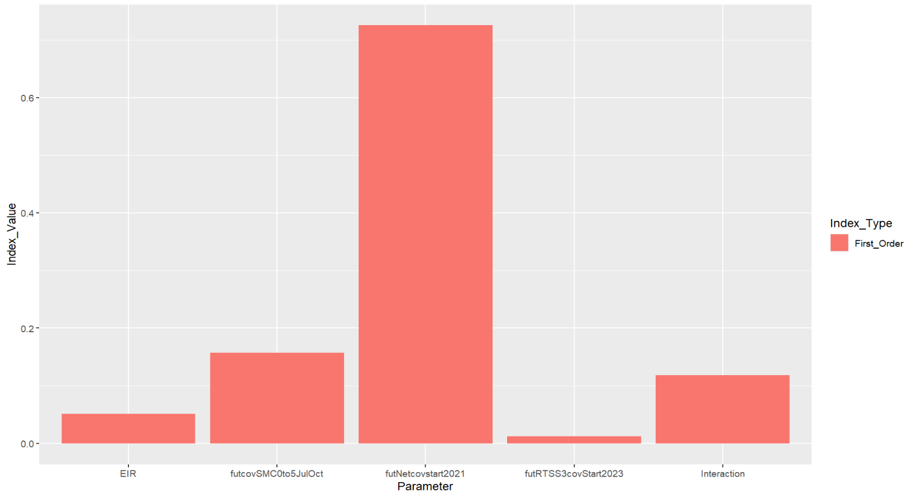
Objective 1 – Sobol’ Sensitivity
Notes:
LLINs is the most influential in determining the output variance

